Slide 1
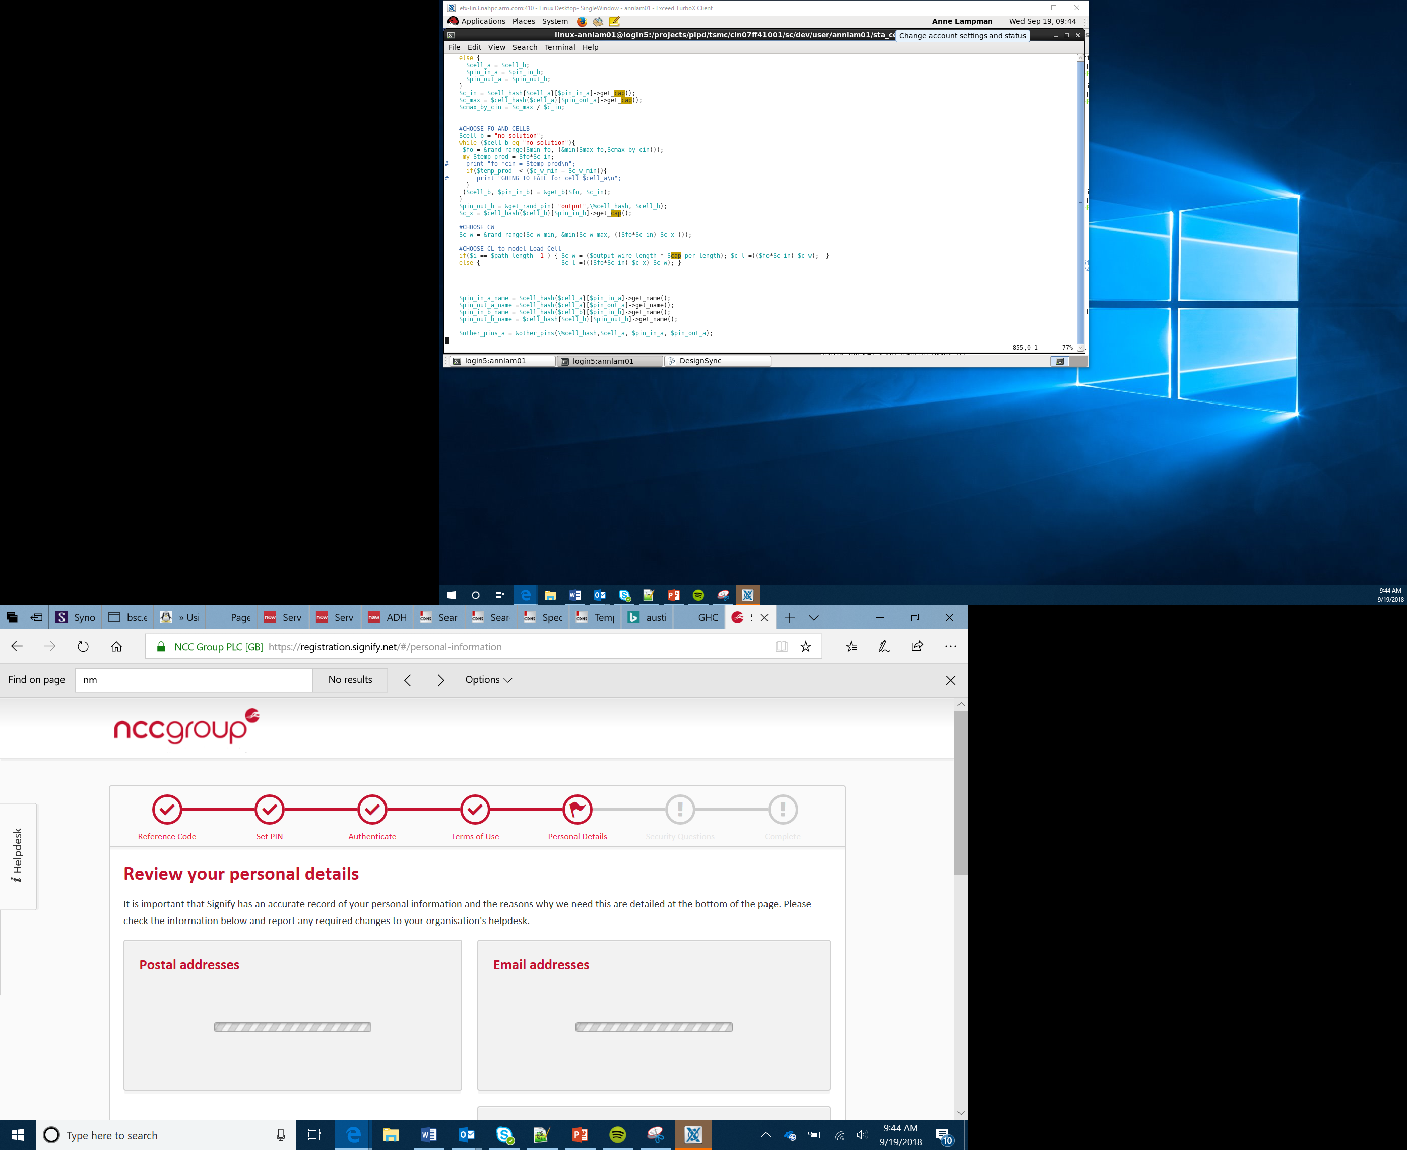

Representing Text and Images in Binary
Lesson 17

Slide 2
Why do computers use binary?
Binary data is a base 2 numbering system which means that it has two states, on and off. This is represented as 1 and 0
Processors are made up of switches and transistors which also only have two states, on and off
In order to process data everything has to be stored as binary

Slide 3
Representation of Text in Binary
When you press a character on the keyboard a series of binary digits are passed to the processor which are then processed. The output is the character appearing on screen
There are three different text libraries which can be used: ASCII, Extended ASCII and Unicode
We are going to focus on ASCII which stands for the American Standard Code for Information Interchange

Slide 4
ASCII
Each character in the ASCII character set is represented using 7 binary digits
If you press and hold Alt on the keyboard and then type in a two digit number on the number pad it when you release Alt it will display the character on the screen
Alt+65 for example is A
In binary 65 is 1000001. The character A would therefore be stored as 1000001 on the computer
64 | 32 | 16 | 8 | 4 | 2 | 1
1 | 0 | 0 | 0 | 0 | 0 | 1
Notes:
The worked example is also provided on the student worksheets. Some may need support to remind them how to convert from denary to binary. Students should now work through the worksheet. If anyone finishes early they could explore the differences between ASCII, Extended ASCII (which uses 8 bits per character), and Unicode (which uses 16 bits per character).

Slide 5
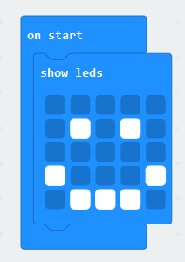
Bitmap Images
When using the micro:bit the screen is made up of a number of LEDs. Each LED can either be on or off. Like all images, this is stored using binary data
Bitmap images are made up of pixels. Each pixel is one individual dot of colour
On the example below the top line of LEDs are all off. We could therefore store this as: 0 0 0 0 0
On the second row two of the LEDs are on. We could store this row as 0 1 0 1 0
If we continue with this we would end up with:
0 0 0 0 0
0 1 0 1 0
0 0 0 0 0
1 0 0 0 1
0 1 1 1 0
We also need to store other data as well. This is known as metadata

Slide 6
Metadata
Metadata is data about data
We know that our image is made up of only 2 colours but we need to tell the computer this as well. Each colour must have a unique binary code: 0 – black, 1 – white in this example
When the processor receives the binary digits they would appear as:
0 0 0 0 0 0 1 0 1 0 0 0 0 0 01 1 0 0 1 0 1 1 1 0
We need to tell the computer how many pixels there are per row
The dimensions of the image would be stored as metadata
Other information such as where the image was taken, the author, date and time would also be stored as metadata
Notes:
Once you have explained the purpose of metadata students should complete the worksheet where they will be creating their own images. More capable students may wish to consider how more than 2 different colours could be used.

Slide 7
Summary
Processors are made up of switches and transistors which only have two states, on and off
All files are stored as binary data so that the processor can process the data
Text uses ASCII, extended ASCII or Unicode to encode characters
Bitmap images are stored as individual pixels, each of which has a binary code attached which represents one colour
Metadata is data about data

